Slide 1

Clinical Resources, Week 1: Why does picture naming matter?
Marianne Casilio, MS, CCC-SLP
Gerasimos Fergadiotis, PhD, CCC-SLP

Slide 2
Presentation Outline
Introduction to Dell’s model
What picture naming tells us
Next week’s clinical resource

Slide 3
Introduction to Dell’s model

Slide 4
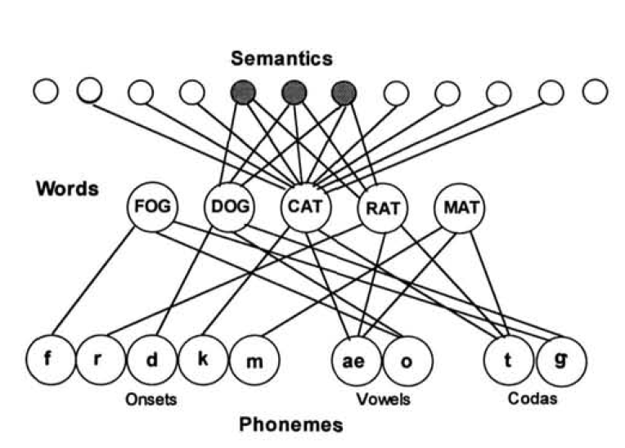
Dell’s model of speech production
(Dell, 1986; Dell & O'Seaghdha, 1992; Dell et al., 1997; Foygel & Dell, 2000; Schwartz et al., 2006)
Step 1:
Lexical-semantic processing
Semantic and syntactic information is mapped to a word form
Step 2:
Phonological processing
Phonemes, stress, and syllable structure are encoded

Slide 5

Dell’s model: An example
SEMANTICS
“Name this picture”
LOG
DOG
CAT
RAT
MAT
WORDS
l
r
d
k
m
æ
ɔ
t
g
PHONEMES
ONSETS
VOWELS
CODAS

Slide 6
Step 1:
Lexical-semantic processing
A jolt of activation is sent to the semantic features of CAT
SEMANTICS
“Name this picture”
LOG
DOG
CAT
RAT
MAT
WORDS
l
r
d
k
m
æ
ɔ
t
g
PHONEMES
ONSETS
VOWELS
CODAS

Slide 7
Step 1:
Lexical-semantic processing
Semantic features activate CAT and semantically similar words
SEMANTICS
“Name this picture”
LOG
DOG
CAT
RAT
MAT
WORDS
Downward spreading activation
l
r
d
k
m
æ
ɔ
t
g
PHONEMES
ONSETS
VOWELS
CODAS

Slide 8
Step 1:
Lexical-semantic processing
CAT and semantically similar words activate corresponding phonemes
SEMANTICS
“Name this picture”
LOG
DOG
CAT
RAT
MAT
WORDS
Downward spreading activation
l
r
d
k
m
æ
ɔ
t
g
PHONEMES
ONSETS
VOWELS
CODAS

Slide 9
Step 1:
Lexical-semantic processing
Phonemes activate phonologically similar words and semantic features of semantically similar words
SEMANTICS
“Name this picture”
WORDS
LOG
DOG
CAT
RAT
MAT
Upward spreading activation
l
r
d
k
m
æ
ɔ
t
g
PHONEMES
ONSETS
VOWELS
CODAS

Slide 10
Step 1:
Lexical-semantic processing
This process repeats itself a given number of times until the most activated word is selected and linked to its syntactic frame
SEMANTICS
“Name this picture”
Noun
Phrase
LOG
DOG
CAT
RAT
MAT
WORDS
Noun
l
r
d
k
m
æ
ɔ
t
g
PHONEMES
ONSETS
VOWELS
CODAS

Slide 11
Step 2:
Phonological processing
A jolt of activation is sent to CAT
SEMANTICS
“Name this picture”
WORDS
LOG
DOG
CAT
RAT
MAT
l
r
d
k
m
æ
ɔ
t
g
PHONEMES
ONSETS
VOWELS
CODAS

Slide 12
Step 2:
Phonological processing
Activation spreads downward to phonemes and upwards to semantic features in the same manner as in Step 1
SEMANTICS
“Name this picture”
LOG
DOG
CAT
RAT
MAT
WORDS
Bidirectional spreading activation
l
r
d
k
m
æ
ɔ
t
g
PHONEMES
ONSETS
VOWELS
CODAS

Slide 13
Step 2:
Phonological processing
After repeating a given number of times, the most activated phonemes are selected and linked to their metrical frame
SEMANTICS
“Name this picture”
Syllable
LOG
DOG
CAT
RAT
MAT
WORDS
On
Vo
Co
l
r
d
k
m
æ
ɔ
t
g
PHONEMES
ONSETS
VOWELS
CODAS

Slide 14
What picture naming tells us

Slide 15
Picture naming tells us…
Healthy Speakers
Patterns and performance variability when linguistic processing is intact.
Speakers with anomia
Patterns and performance variability when linguistic processing is impaired. Specifically, picture naming tells us which linguistic processes are impaired and to what degree.
Evaluating the type and frequency of paraphasias is critical to understanding whether linguistic processing is impaired and which specific processes are affected.

Slide 16
Returning to Dell’s model
Breakdowns in lexical-semantic processing
Real-word paraphasias that are semantically and/or phonologically similar to the target
Breakdowns in
phonological processing
Non-word paraphasias that may or may not be phonologically similar to the target

Slide 17
Beyond picture naming
Lexical-semantic and phonological processing are critical to all language tasks.
Level of Impairment | Comprehension Tasks
 | Nonword minimal pairs | Auditory lexical decision | Spoken word comprehension | Written word comprehension | Picture-matching with phonological distractors | Picture-matching with low-imageability words
Lexical-semantic processing | ✓ | ✓ | ✗ | ✗ | ✓ | ✗
Phonological processing | ✗ | ✗ | ✗ | ✓ | ✗ | ✓
Using a neuropsychological framework like Dell’s model is an evidence-based, theoretically driven approach to diagnostic decision-making and treatment planning in aphasia.
(Whitworth, Webster, & Howard, 2014)

Slide 18
Next week’s clinical resource

Slide 19
Next week: Paraphasia types and Dell’s model
Brief review of this week’s clinical resource
How lexical paraphasias fit within Dell’s model
How nonlexical paraphasias fit within Dell’s model
Clinical assessment applications

Slide 20
References for further reading
Dell, G. S. (1986). A spreading-activation theory of retrieval in sentence production. Psychological review, 93(3), 283.
Dell, G. S., & O'Seaghdha, P. G. (1992). Stages of lexical access in language production. Cognition, 42(1-3), 287-314.

